Slide 1
Introduction to Disease Transmission Modeling
한국보건정보통계학회 춘계연수교육
김종훈
11 June 2021

Slide 2
Topics
Infectious diseases
Dynamics of an outbreak
Scientific modeling, modeling philosophy
Building a simple model for a disease outbreak
Epidemiological concepts: basic reproduction number (R₀), herd immunity, effective reproduction number (R_{t})
Extensions to the simple model: age structure, asymptomatic transmission, spatial structure
Parameter estimation using a simple model
Notes:
.

Slide 3
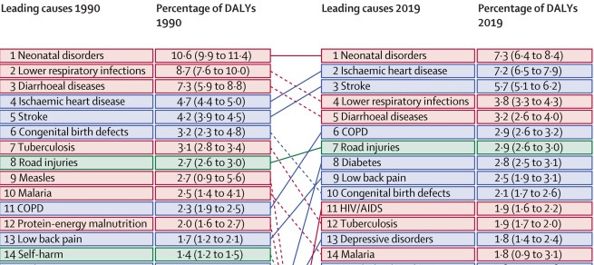
Infectious diseases are a big contributor to GBD
Lancet. 2020 Nov 14;396(10262):1562. doi: 10.1016/S0140-6736(20)32226-1.
Notes:
Widespread disinfection of community drinking water beginning in the early 20th century has led to the suppression of infectious diseases in wealthy countries. Subsequently, sustained investment into clean water infrastructure and improvements in sanitation and hygiene lead to one of the greatest public health achievements of the last century. While this level of success has lagged in many low and middle-income countries, incremental improvements in water, sanitation and hygiene (WASH) infrastructure may impart important benefits to populations living in disease endemic environments.

Slide 4
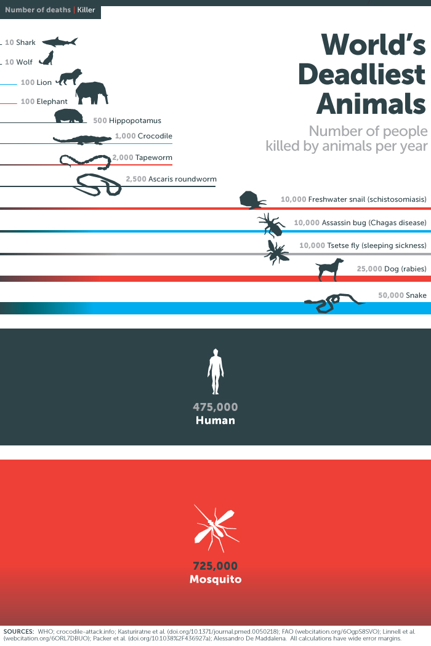
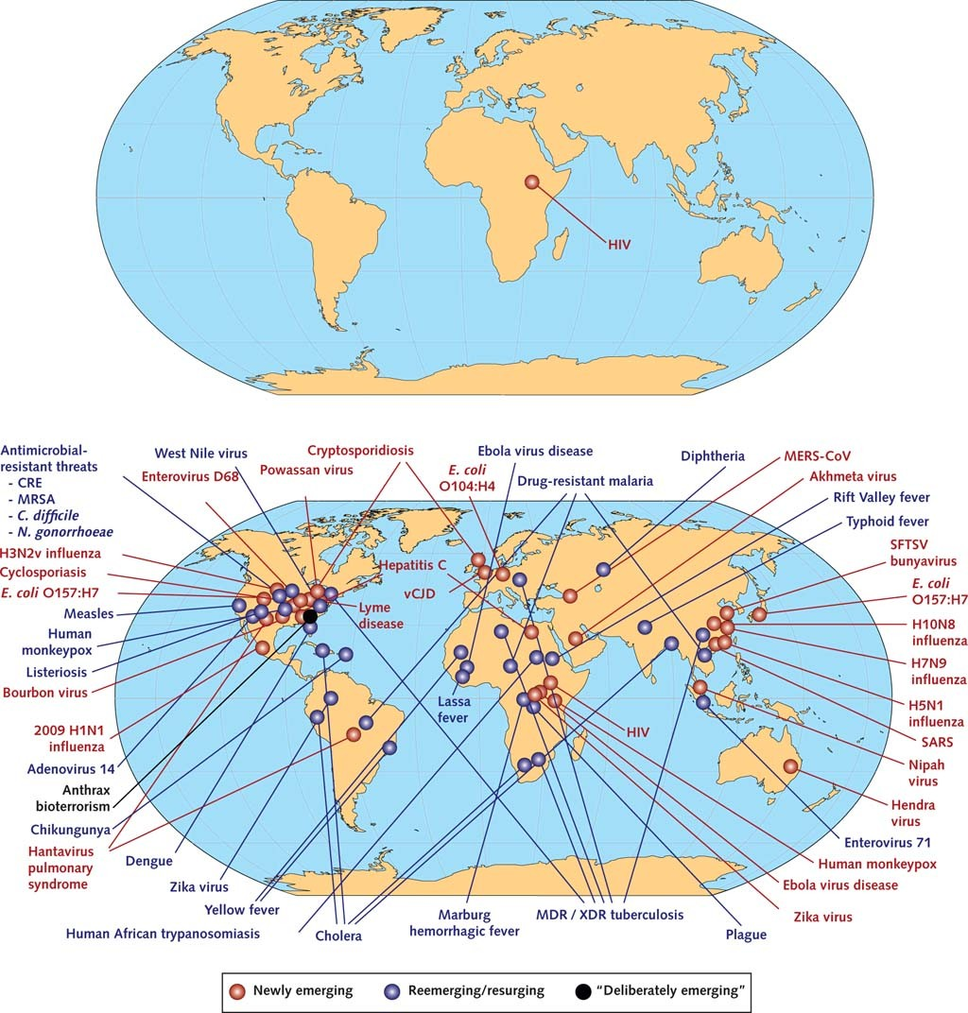
The Deadliest animal in the world
Re(emerging) infectious diseases
Gates Notes (2014)
Paules et al. (2017) Ann Intern Med. 2017;167:805-811

Slide 5
Current status of COVID-19
https://www.economist.com/graphic-detail/tracking-coronavirus-across-the-world
https://ourworldindata.org/grapher/covid-stringency-index?tab=chart&country=KOR~USA~JPN~ITA~GBR~ISR~CHL
https://www.google.com/search?q=korea+covid+cases&rlz=1C1GCEU_koKR936KR936&oq=korea+covid&aqs=chrome.1.0l3j0i457j0j69i60l3.18231j0j7&sourceid=chrome&ie=UTF-8
Notes:
MENA = Middle East and North Africa

Slide 6
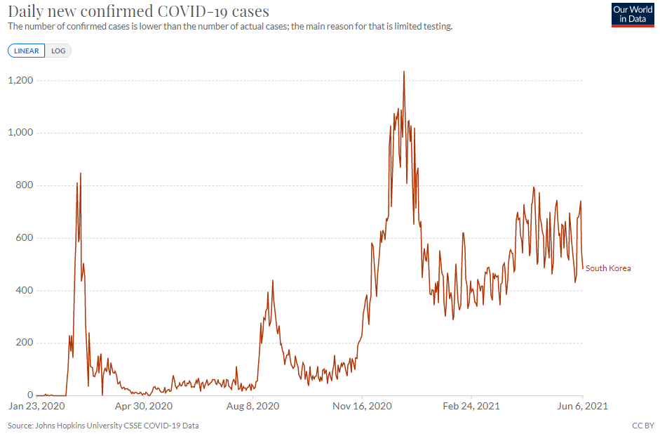
Our goal is to understand general characteristics of an outbreak
Notes:
Widespread disinfection of community drinking water beginning in the early 20th century has led to the suppression of infectious diseases in wealthy countries. Subsequently, sustained investment into clean water infrastructure and improvements in sanitation and hygiene lead to one of the greatest public health achievements of the last century. While this level of success has lagged in many low and middle-income countries, incremental improvements in water, sanitation and hygiene (WASH) infrastructure may impart important benefits to populations living in disease endemic environments.

Slide 7
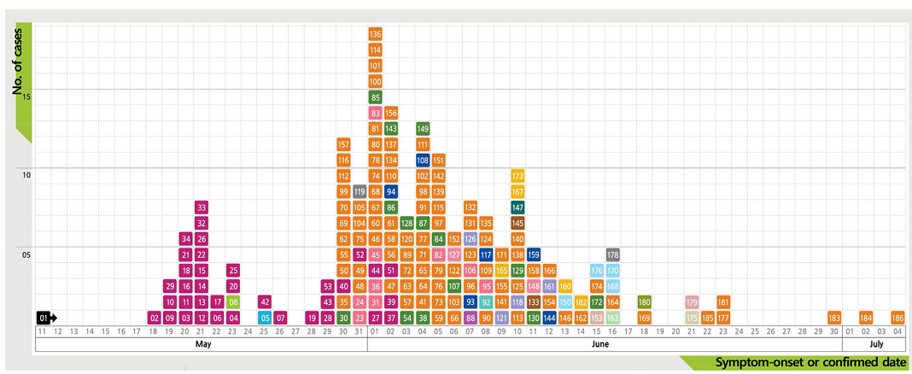
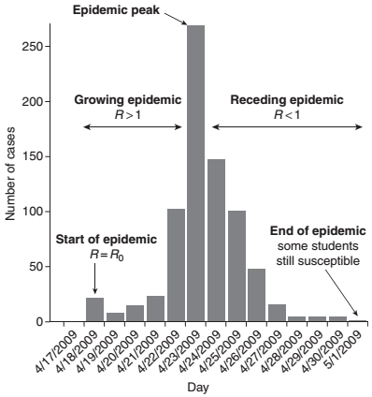
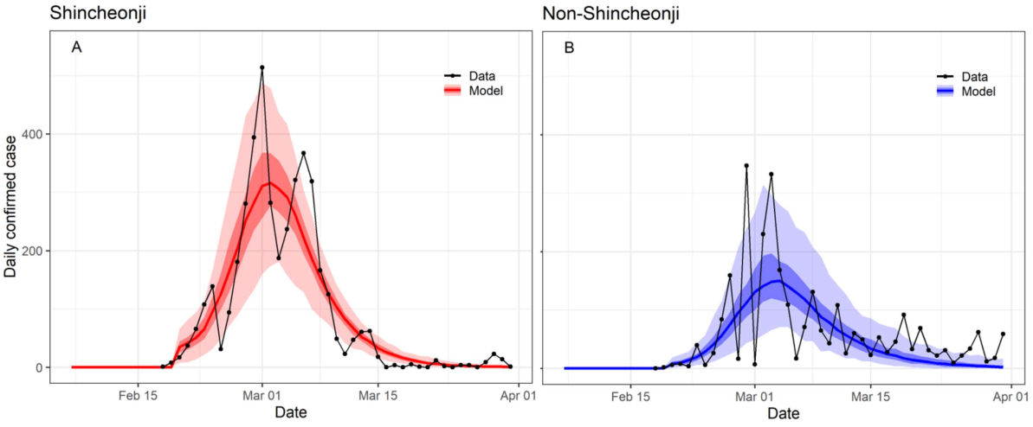
Infectious disease outbreaks have a similar shape
2015 MERS outbreak
2009 H1N1 (swine flu) outbreak in New York
2020 COVID-19 outbreak in Daegu

Slide 8
Exponential growth but bounded by the number of susceptibles
I(t) = 2^{t}
Simple exponential growth is not sufficient to explain that the number of infected people is bounded by the number of susceptible people

Slide 9
Exponential decay
People recover at a constant rate. More people recover than the number of new infections.

Slide 10
2009 H1N1 (swine flu) outbreak in New York
No. of newly infected persons increase because there are sufficient number of susceptibles for each infectious person to infect >1 other people.
Proportion of susceptible people (S) decreases over time. Once S is sufficiently low, each infectious person generates <1 new infection and thus no. of infectious people starts to decrease while infected people recover.

Slide 11
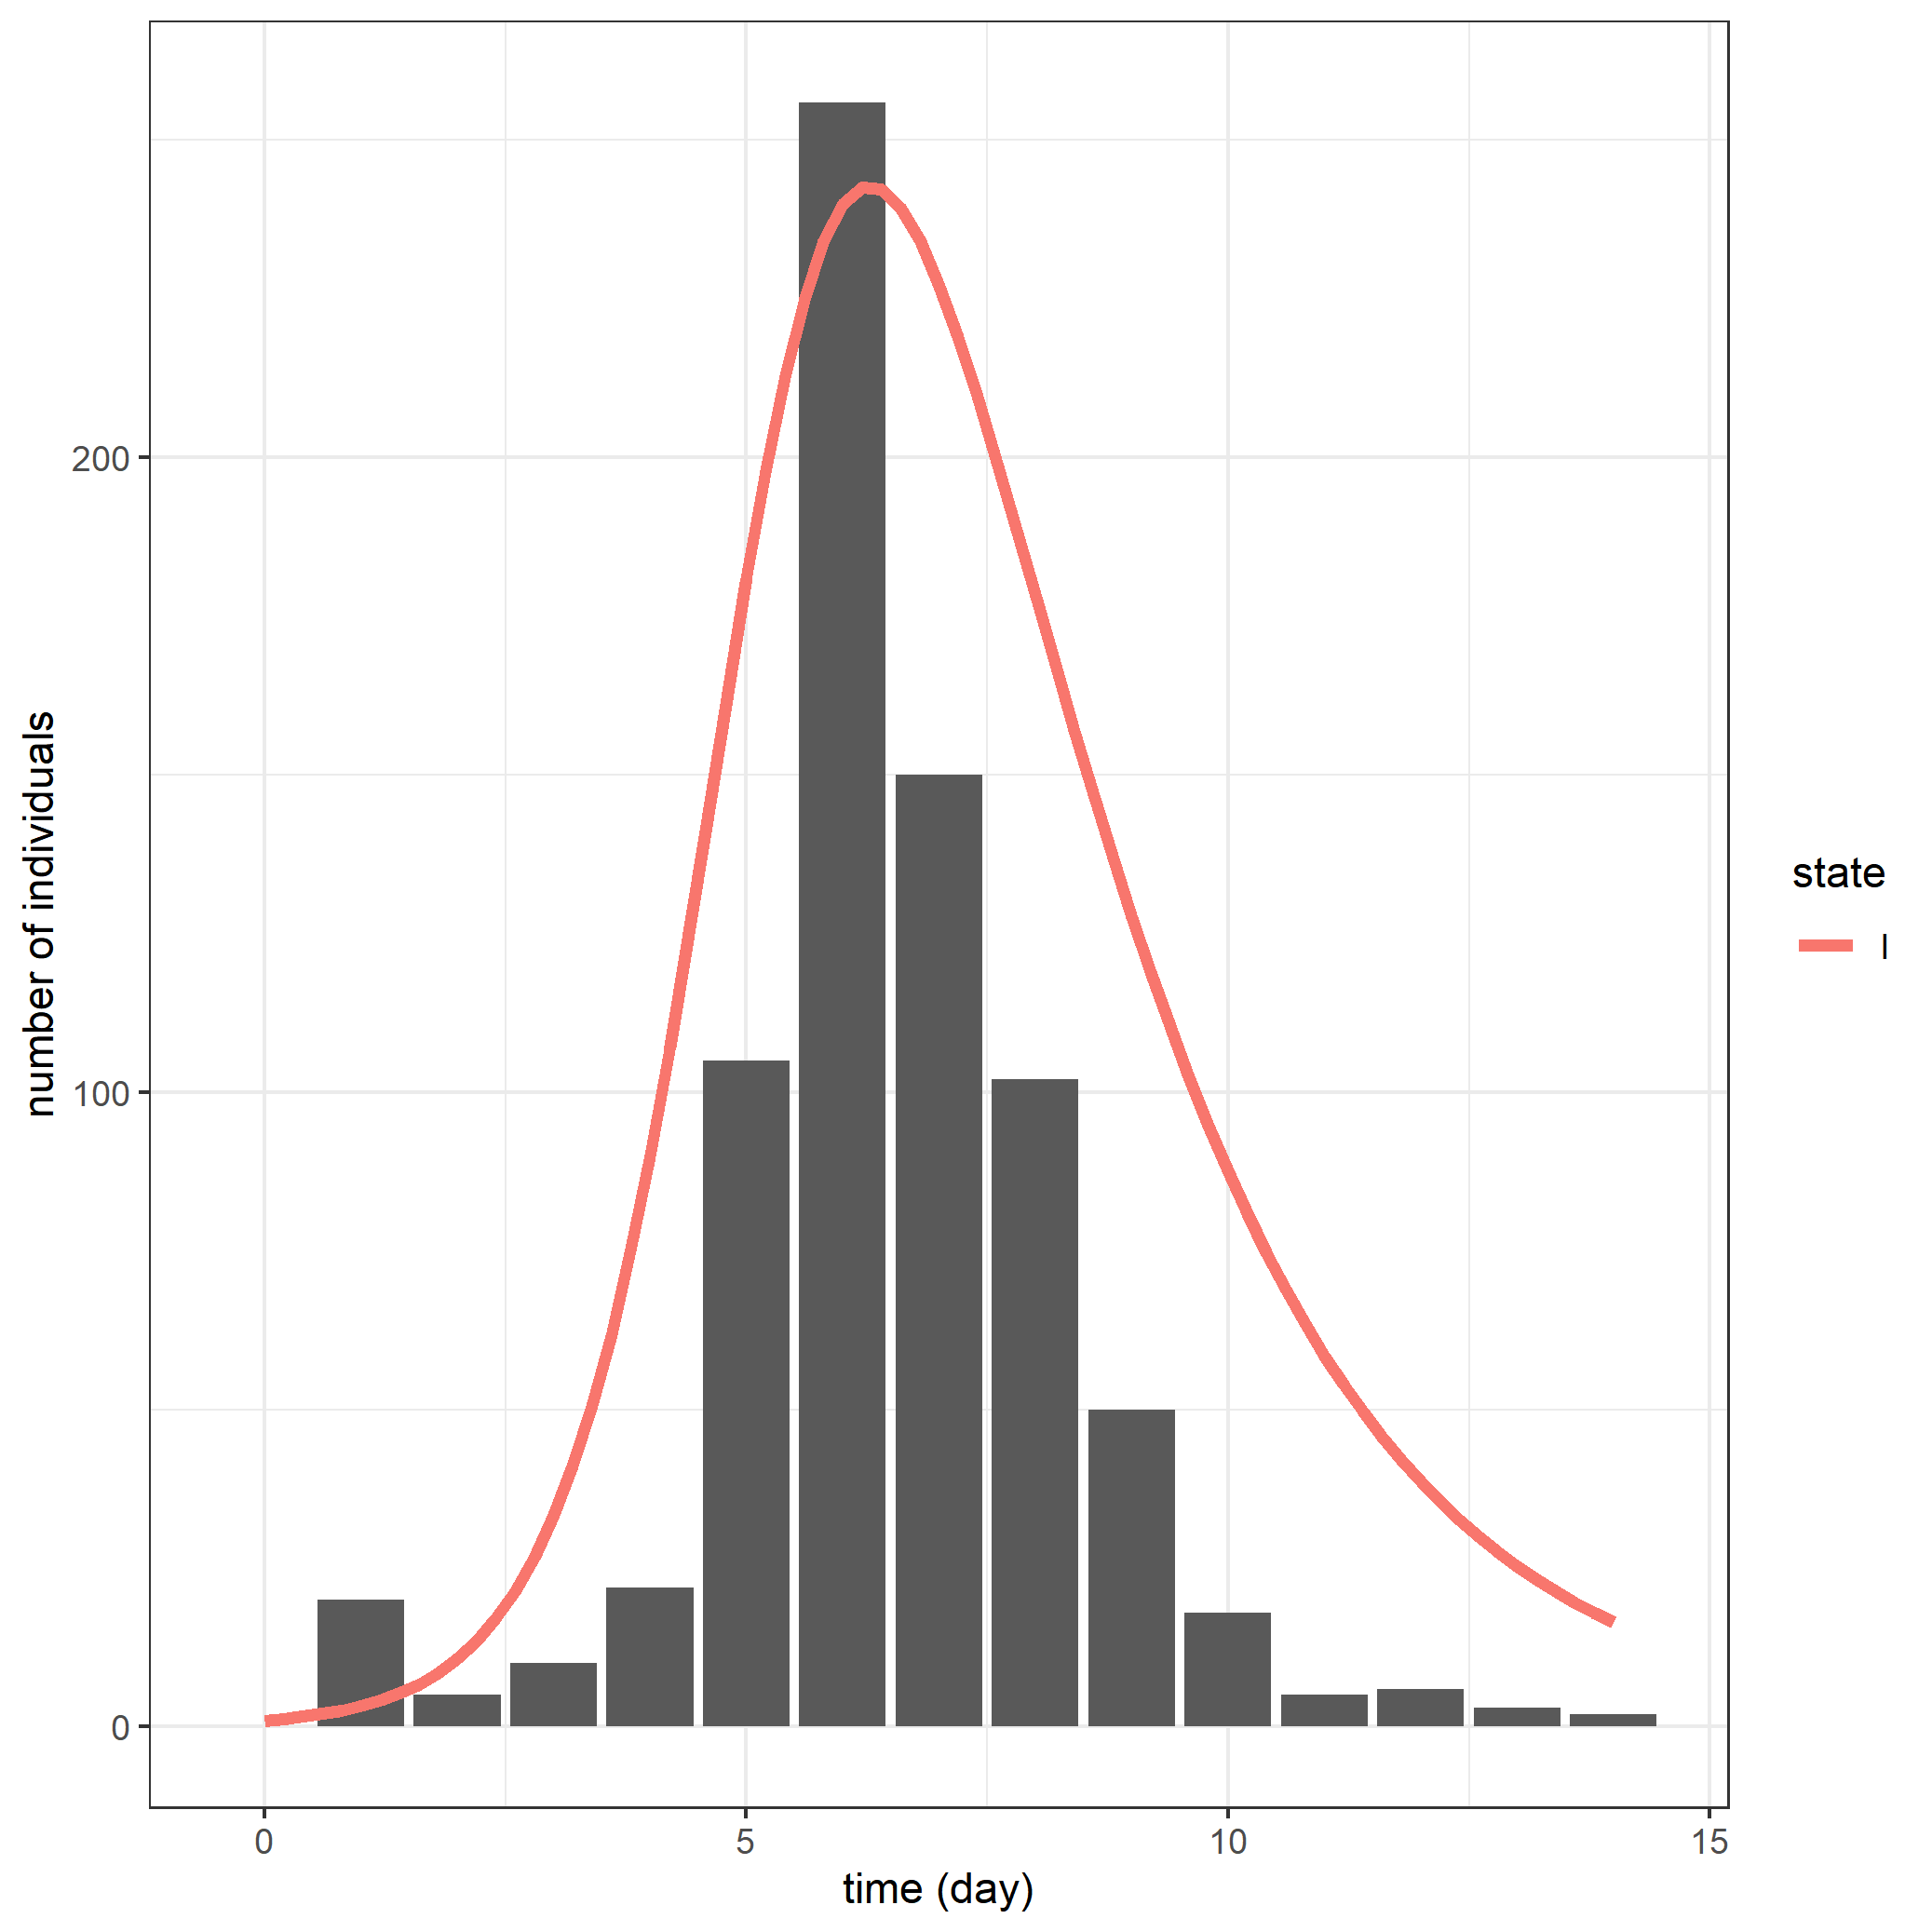
SIR model for the 2009 H1N1 (swine flu) outbreak in New York

Slide 12
Scientific modeling
Making a particular part or feature of the world easier to understand, define, quantify, visualize, or simulate (Scientific modelling, Wikipedia)
Doing so by referencing it to commonly accepted knowledge
Different types of models for different aims (e.g., conceptual models to better understand and mathematical models to quantify)
Mathematical model for the transmission of a disease
Notes:
Widespread disinfection of community drinking water beginning in the early 20th century has led to the suppression of infectious diseases in wealthy countries. Subsequently, sustained investment into clean water infrastructure and improvements in sanitation and hygiene lead to one of the greatest public health achievements of the last century. While this level of success has lagged in many low and middle-income countries, incremental improvements in water, sanitation and hygiene (WASH) infrastructure may impart important benefits to populations living in disease endemic environments.

Slide 13
Modeling philosophy
"All models are wrong, but some are useful."
--- George Box (1976) Science and statistics
“Everything should be made as simple as possible, but no simpler.”
--- Albert Einstein
Notes:
All models are wrong, but some are useful. It’s worth reading the fuller context of the quote: Now it would be very remarkable if any system existing in the real world could be exactly represented by any simple model. However, cunningly chosen parsimonious models often do provide remarkably useful approximations. For example, the law PV = RT relating pressure P, volume V and temperature T of an “ideal” gas via a con‐ stant R is not exactly true for any real gas, but it frequently provides a useful approximation and furthermore its structure is informative since it springs from a physical view of the behavior of gas mole‐ cules. For such a model there is no need to ask the question “Is the model true?” If “truth” is to be the “whole truth” the answer must be “No.” The only question of interest is “Is the model illuminating and use‐ ful?” The goal of a model is not to uncover truth, but to discover a simple approximation that is still useful

Slide 14
Mathematical model
A mathematical model is a description of a system using mathematical concepts and language.
A model may help to explain a system and to study the effects of different components, and to make predictions about behavior.

Slide 15
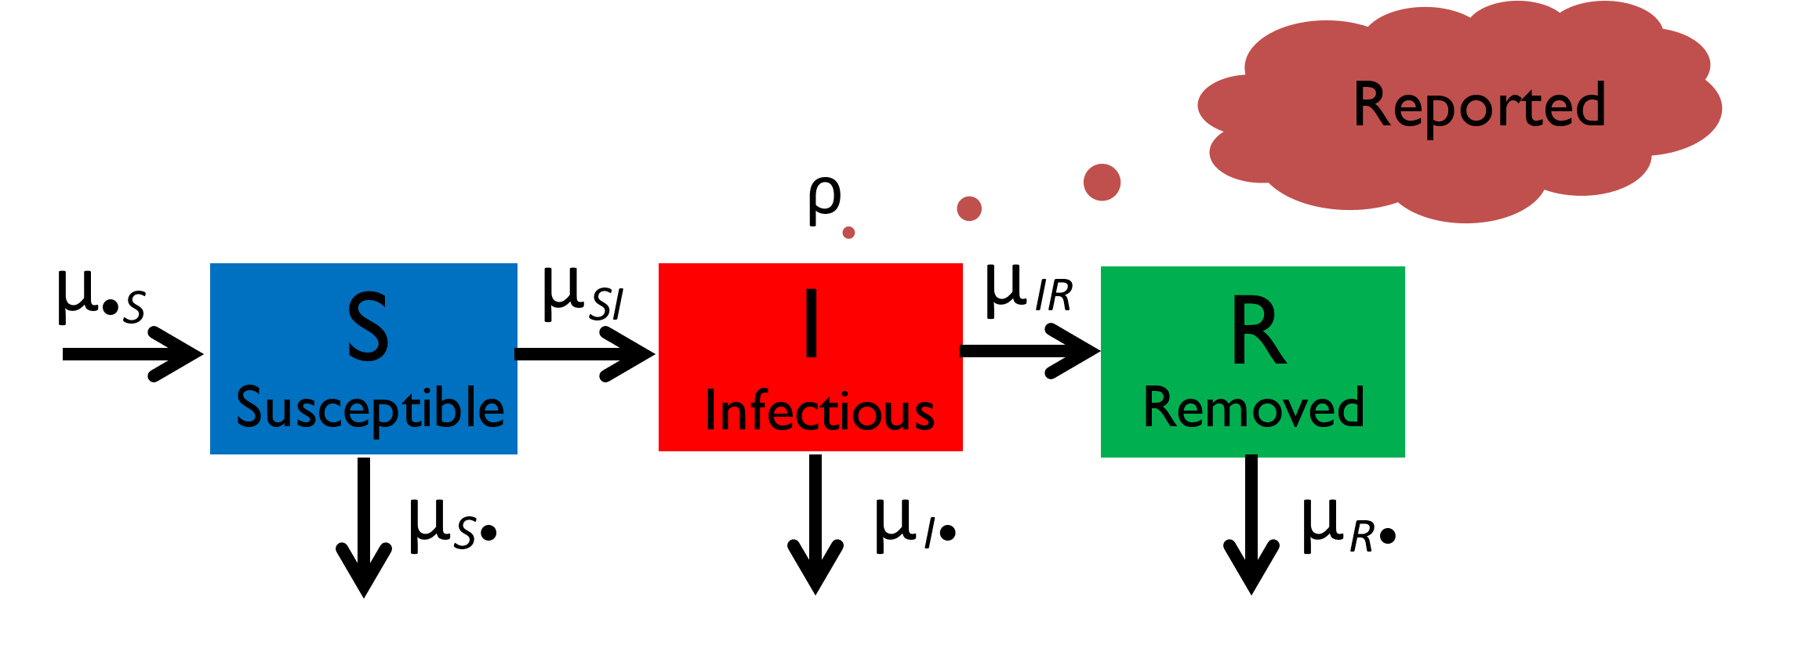
Susceptible-Infected-Recovered (SIR) model
Population is divided into three different classes: Susceptible, Infected, and Recovered
The model describes how the number of people in each class changes with time
Each arrow has an associated rate
Captures a characteristic growth and decay of the number of infectious individuals

Slide 16
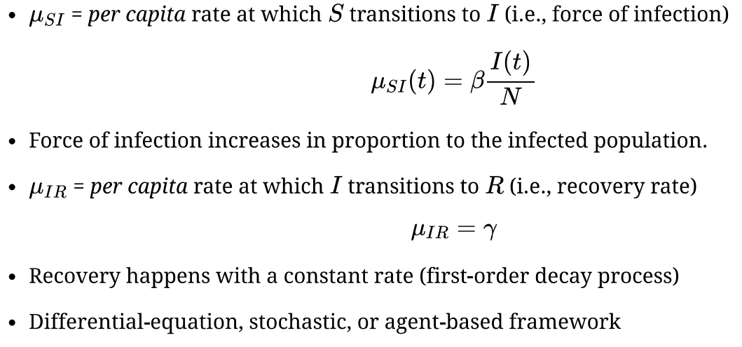
SIR model (contd.)

Slide 17
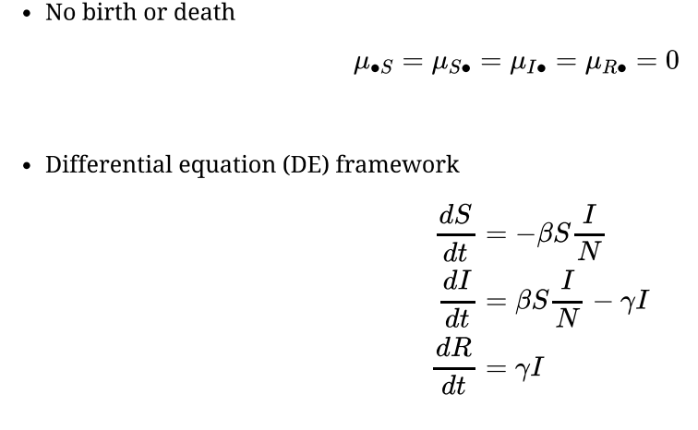
Simplest SIR model

Slide 18
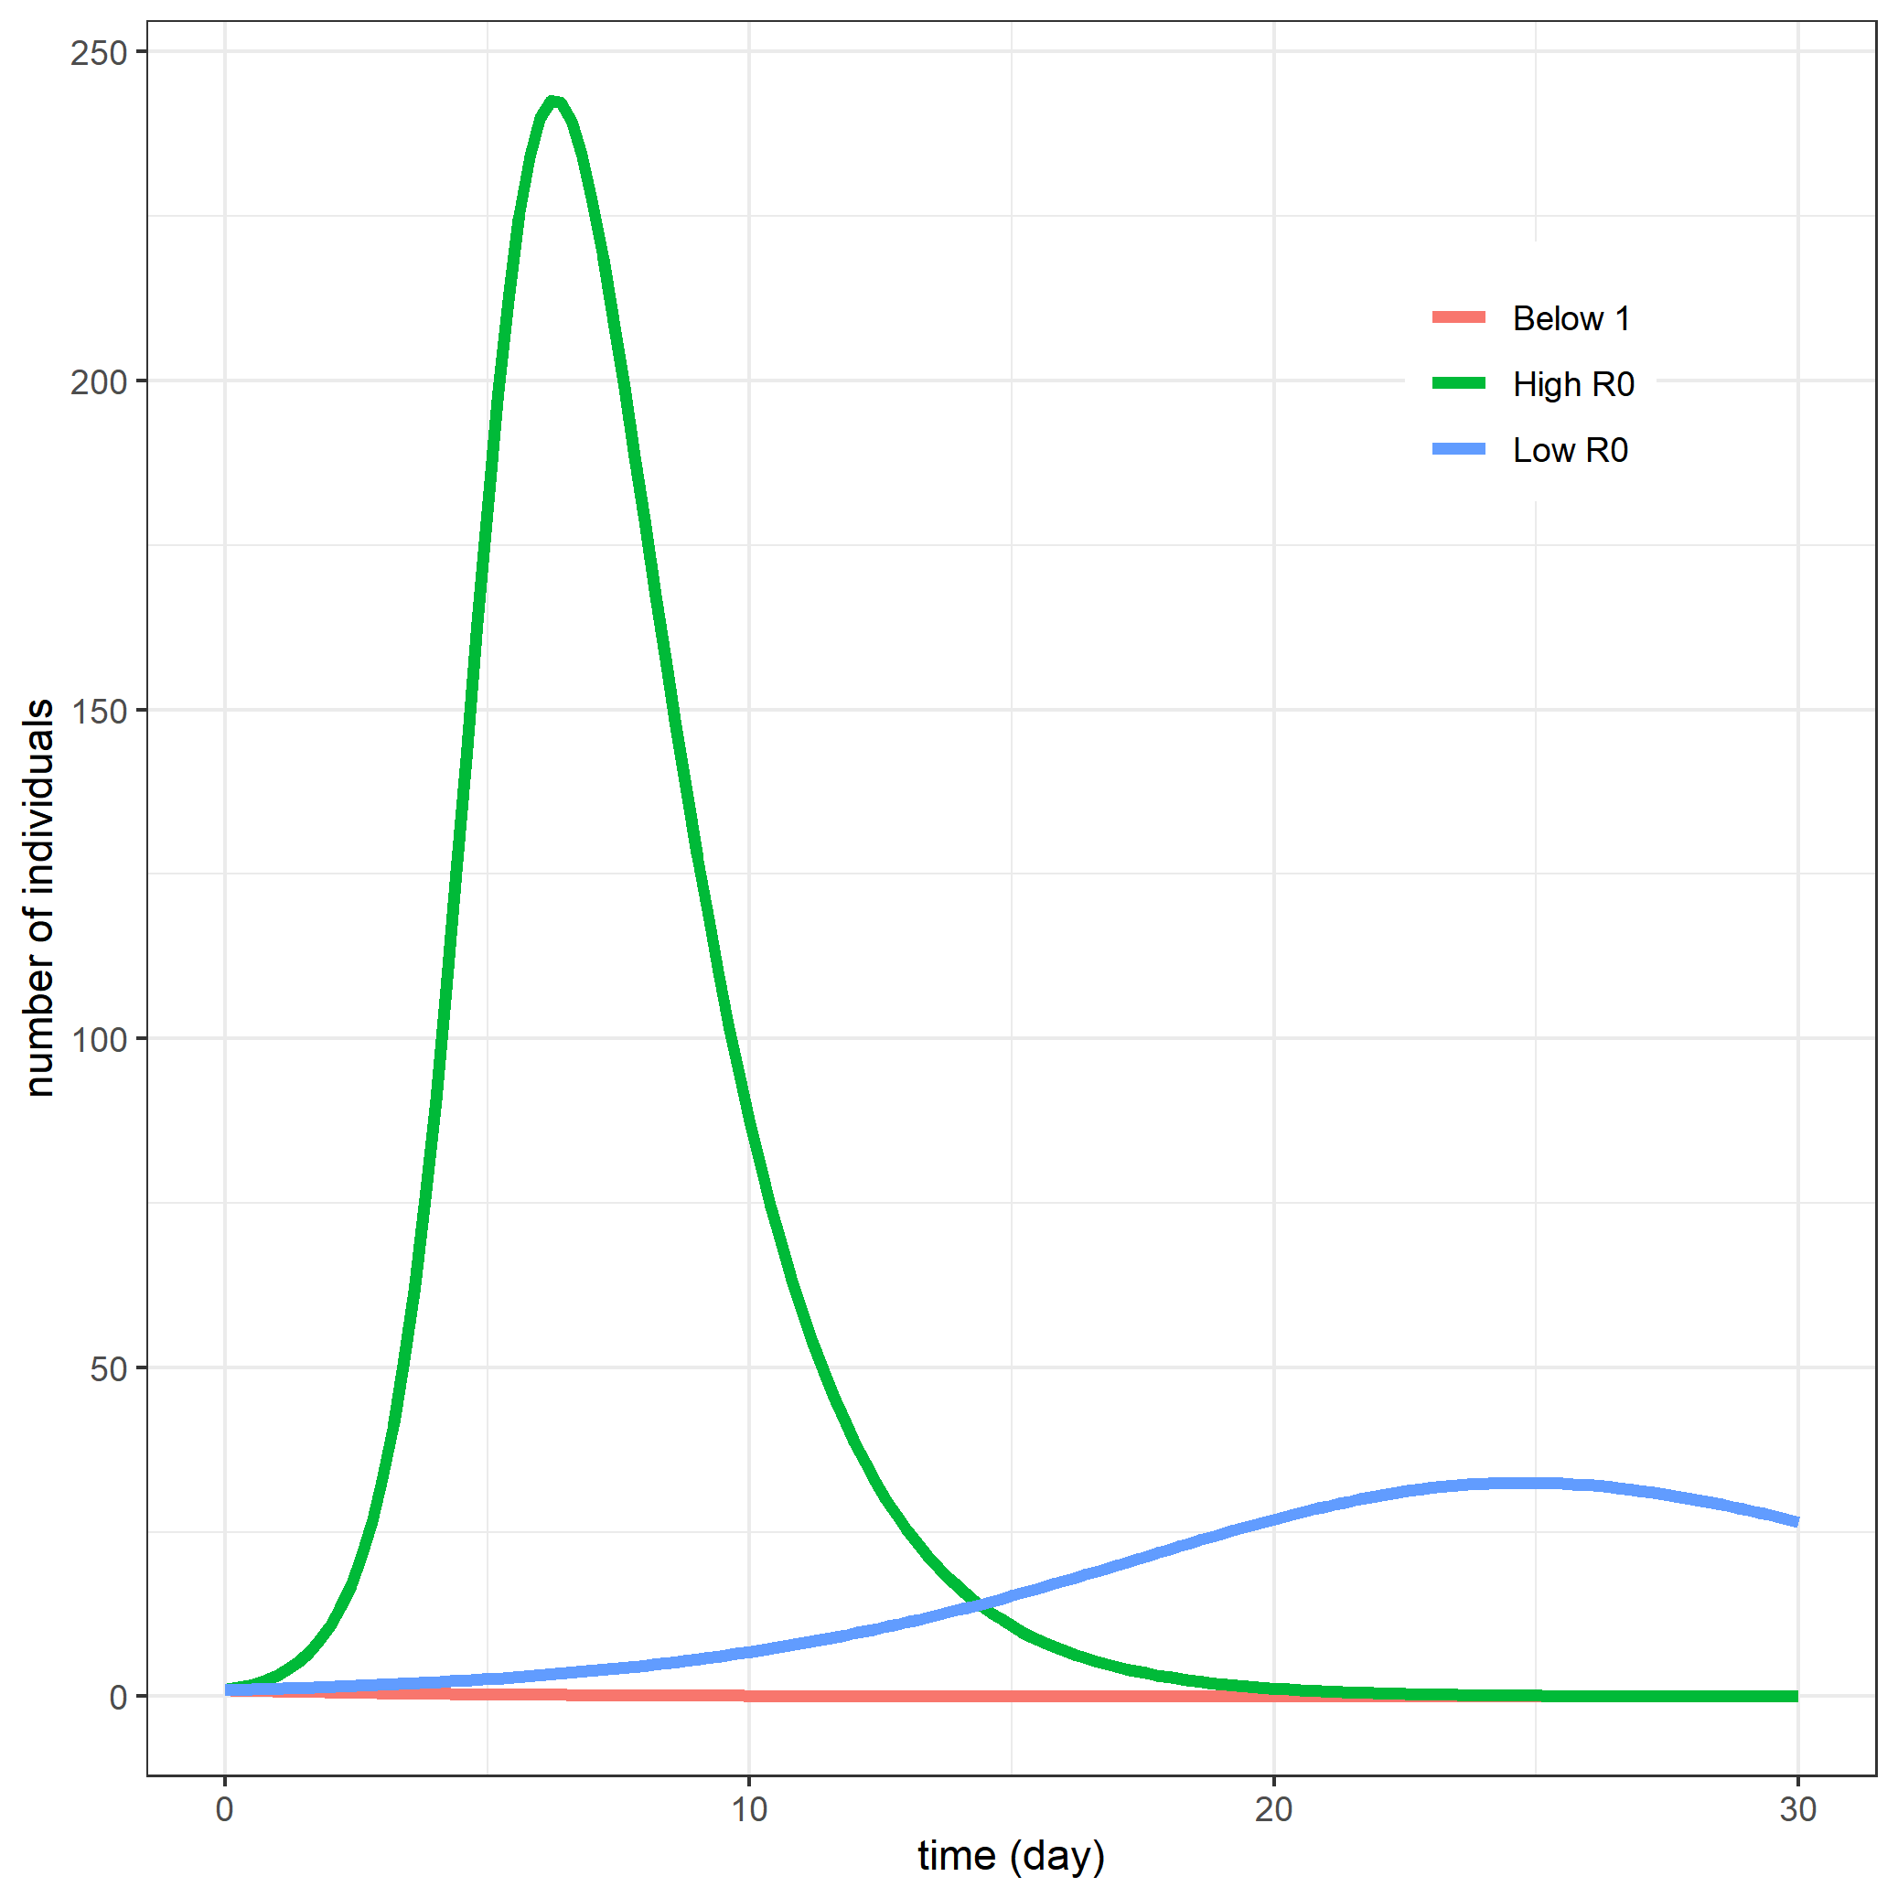
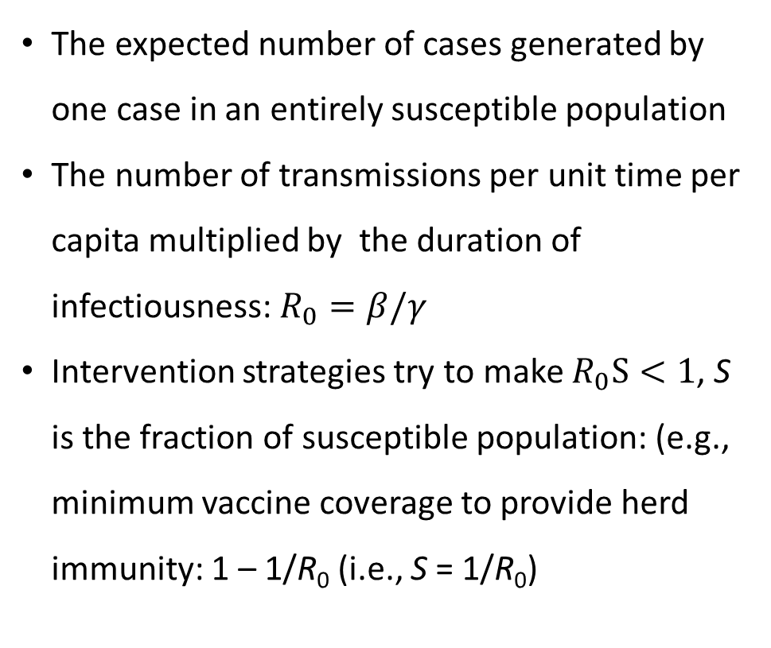
Basic reproduction number, R₀
The expected number of cases generated by one case in an entirely susceptible population
The number of transmissions per unit time per capita multiplied by the duration of infectiousness: $R_{0}=β/γ$
Intervention strategies try to make $R_{0}S<1$, S is the fraction of susceptible population: (e.g., minimum vaccine coverage to provide herd immunity: 1 – 1/R₀ (i.e., S = 1/R₀)

Slide 19
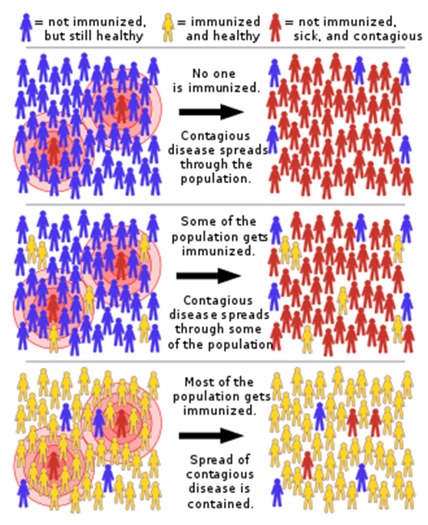
Herd immunity
A form of indirect protection from infectious disease that occurs when a large percentage of a population has become immune to an infection, thereby providing a measure of protection for individuals who are not immune.
Critical vaccination threshold = (1 – 1/R₀) / VE *100%, VE = vaccine efficacy

Slide 20
R implementation of SIR model
closed_sir_model <- function (t, y, params) {
## first extract the state variables
S <- y[1]
I <- y[2]
R <- y[3]
## now extract the parameters
beta <- params["beta"]
gamma <- params["gamma"]
N <- S+I+R
muSI <- beta*I/N
muIR <- gamma
## now code the model equations
dSdt <- - muSI*S
dIdt <- muSI*S - muIR*I
dRdt <- muIR*I
## combine results into a single vector
dydt <- c(dSdt, dIdt, dRdt)
## return result as a list!
list(dydt)
}

Slide 21
Parameters, initial values, and simulation times
params <- c(beta = 1/2, gamma = 1/5) # parameters
y0 <- c(S = 999, I = 1, R = 0) # initial values
times <- seq(from = 0, to = 60, by = 1) # times
Simulate using deSolve package
library(deSolve) # numerical integration
library(tidyverse) # data manipulation
ode(func = closed_sir_model, y = y0, times = times, parms = params) %>%
as.data.frame() -> out

Slide 22
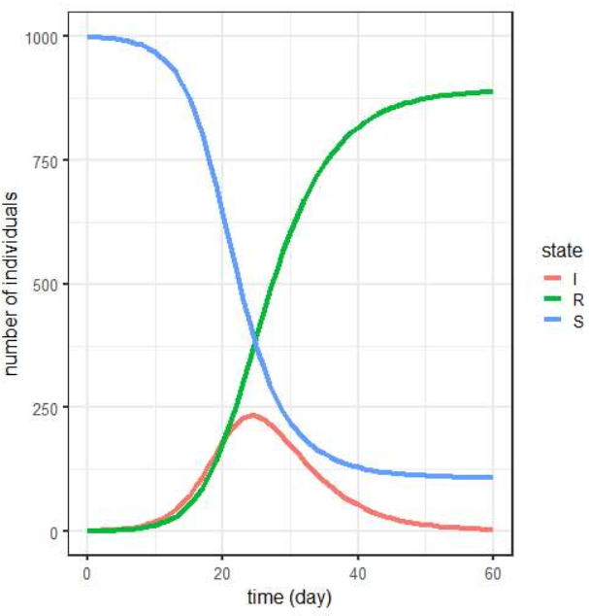
Time evolution of S, I, and R

Slide 23
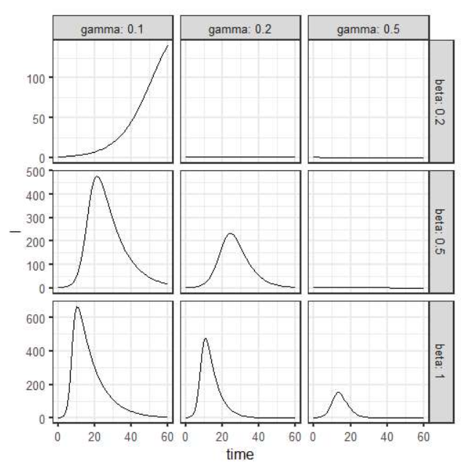
Parameter space exploration

Slide 24
Extensions to the simple model

Slide 25
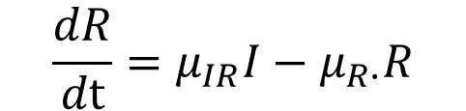
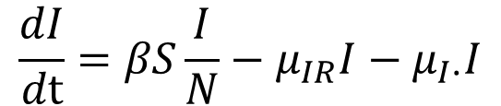
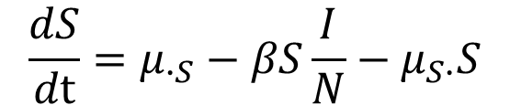
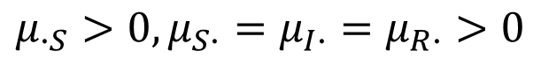
SIR model with demographics
$$μ_{∙S}>0,μ_{S∙}=μ_{I∙}=μ_{R∙}>0$$
$${\frac{dS}{dt}=μ}_{∙S}−βS\frac{I}{N}−μ_{S∙}S$$
$$\frac{dI}{dt}=βS\frac{I}{N}−μ_{IR}I−μ_{I∙}I$$
$$\frac{dR}{dt}=μ_{IR}I−μ_{R∙}R$$

Slide 26
R implantation of the SIR model with demographics
open_sir_model <- function (t, y, params) {
B <- params["B"]
beta <- params["beta"]
mu <- params["mu"]
gamma <- params["gamma"]
N <- y[1]+y[2]+y[3]
muSI <- beta*y[2]/N
muIR <- gamma
dSdt <- B - muSI*y[1]- mu*y[1]
dIdt <- muSI*y[1] - (mu+muIR)*y[2]
dRdt <- muIR*y[2] - mu*y[3]
list(c(dSdt, dIdt, dRdt))
}

Slide 27
Parameters, initial values, and simulation times
params <- c(B=20/365, mu=1/(50*365), beta=1.2, gamma=1/10)
y0 <- c(S=999, I=1, R=0)
times <- seq(from=0, to=30*365, by=1)
Simulate
ode(func = open_sir_model, y = y0, times = times, parms = params) %>%
as.data.frame() -> out
Visualize
out %>%
gather( state, value, -time) %>%
ggplot(aes(x=time/365,y=value,color=state)) + geom_line()+
facet_wrap(~state, scales="free_y", ncol=1 ) +
scale_y_log10()

Slide 28
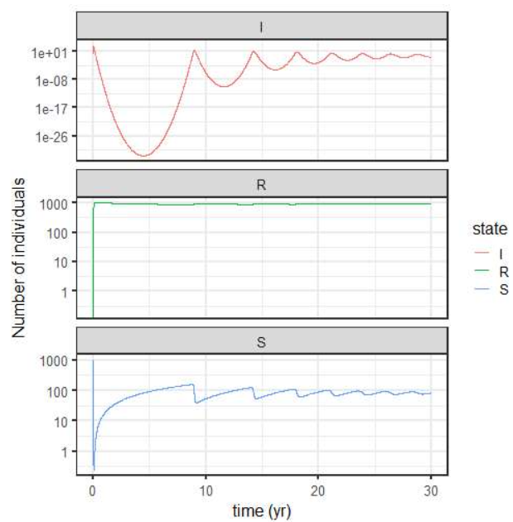
S, I, R over time

Slide 29
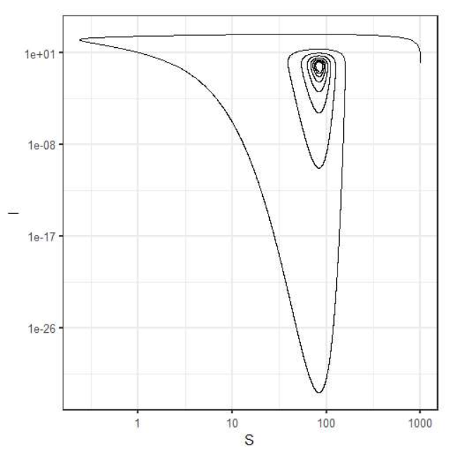
S vs. I

Slide 30
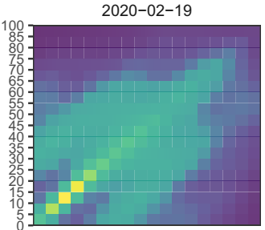
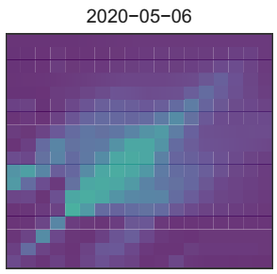
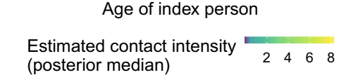
Age-specific contact
Monod et al. (2021) Science 371, 1336
Notes:
Data from the US. Before and after the COVID-19 spread.
The first COVID-19 confirmed case was on Jan 20, 2020 as in Korea

Slide 31
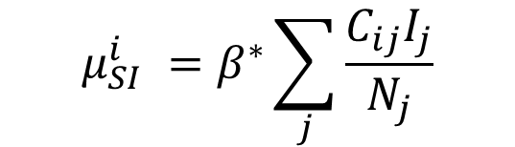
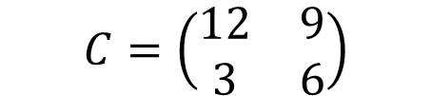
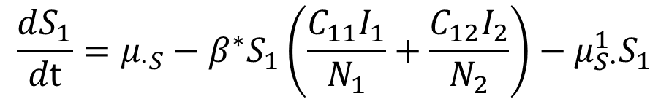
SIR model with age-specific contact
Contact matrix for two age classes (kids = 25%, adults = 75%)
μ
I
μ
$$C=\left(\begin{matrix}12 & 9 \\ 3 & 6\end{matrix}\right)$$
•S
S
IR
R
1
μ
1
1
Susceptible
1
Infectious
Removed
SI
μ
μ
μ
1
1
1
S
•
I
•
R
•
μ
μ
S
2
I
IR
R
SI
2
2
2
Susceptible
Infectious
Removed
2
2
2
$$μ_{SI}^{i} =β^{∗}\sum_{j}{\frac{C_{ij}I_{j}}{N_{j}}}$$
μ
μ
μ
S
•
I
•
R
•
$${\frac{dS_{1}}{dt}=μ}_{∙S}−β^{∗}S_{1}\left(\frac{C_{11}I_{1}}{N_{1}}+\frac{C_{12}I_{2}}{N_{2}}\right)−μ_{S∙}^{1}S_{1}$$

Slide 32
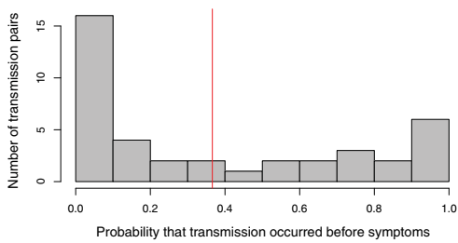
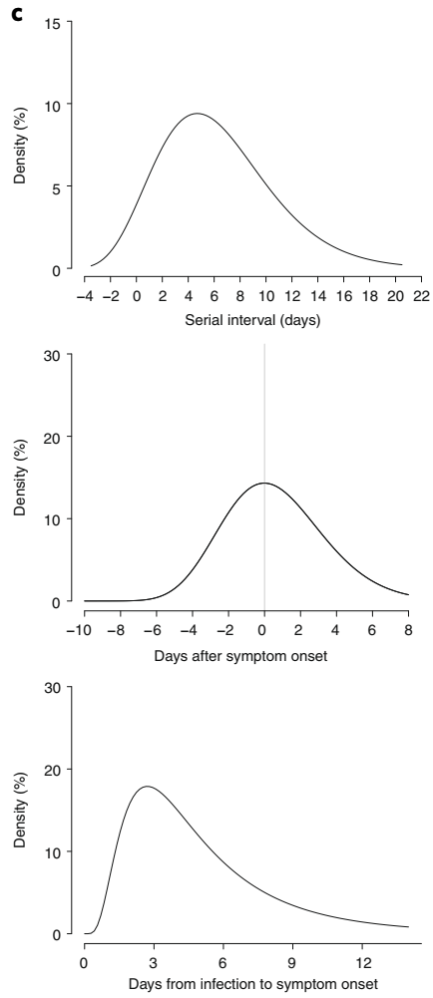
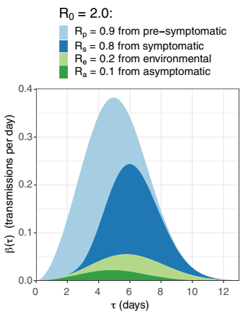
Pre-symptomatic and asymptomatic transmission
77 transmission pairs
40 transmission pairs
Serial interval
Infectiousness profile
Ferretti et al. (2020) Science
Incubation period
He et al. (2020) Nature Medicine

Slide 33
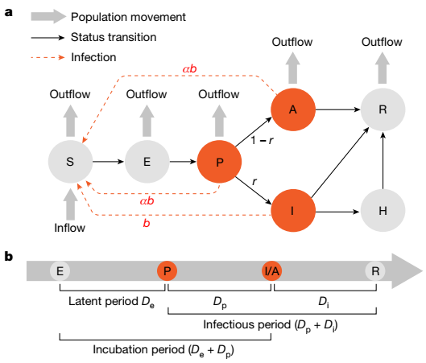
SAPHIRE model
Hao et al. (2020) Nature

Slide 34
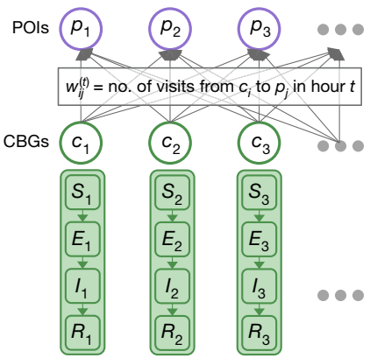
Spatial structure
Modeling the hourly movements of 98 million people from census block groups (CBG), which are geographical units that typically contain 600-3,000 people, to specific points of interest (POIs).
Chang et al. (2021) Nature

Slide 35
Parameter estimation

Slide 36
Modeling process
Ask questions
Collect data
Model
(Process & measurement)
Estimate parameters
(Point & interval)
Answer questions
Adpated from Bolker (2007) Ecological Models and Data in R (p.27)

Slide 37
Modeling the measurement error
Data, y_{t}, are the result of the sampling process
Binomial distribution: infected individuals are reported with a probability p
y_{t} ⁓ Binomial(Y_{t}, p),
where Y_{t} is the number of infected people at time t predicted by the process model
Poisson distribution: the number of infected individuals is a Poisson random variables with a mean predicted by the process model
y_{t} ⁓ Poisson(Y_{t}).

Slide 38
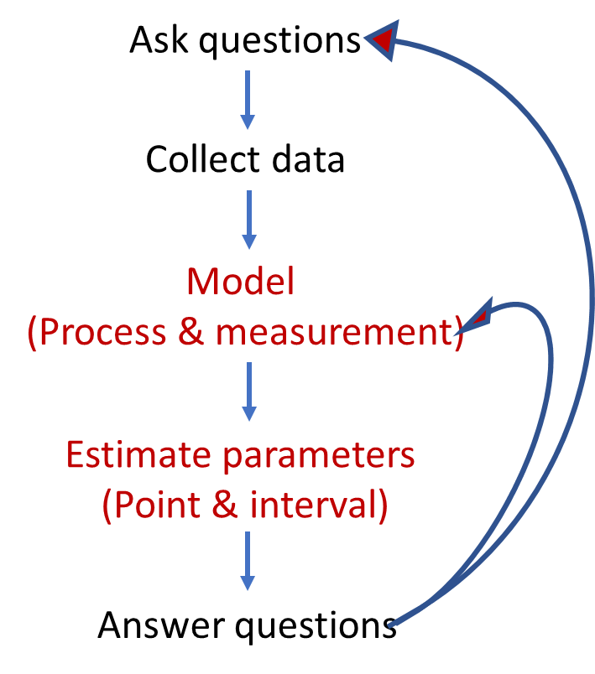
Parameter estimation
Inverse problem
Find model parameters that make the data most likely
Quantify the discrepancy between model prediction and data
Least square or likelihood-based methods

Slide 39
Likelihood-based inference
Likelihood = the probability of seeing the data given a particular model
The basis for modern frequentist , Bayesian, and information-theoretic inference
Method of maximum likelihood introduced by Fisher (1922)
We want the maximum likelihood estimates of the parameters

Slide 40
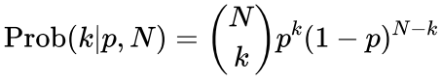
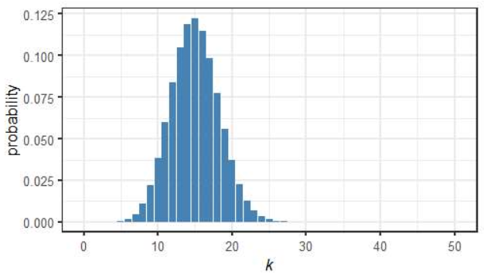
Likelihood for a binomial distribution
Probability of having k out of N:
Suppose 3% of the population has been infected with COVID-19. What is the probability of k infected people in a sample of size n = 50

Slide 41
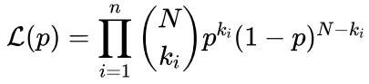
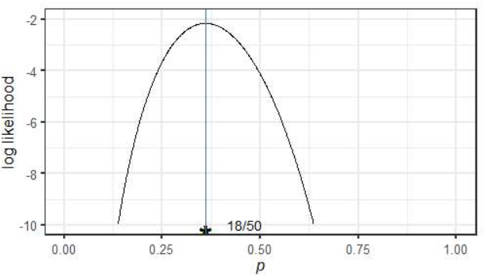
Likelihood for a binomial distribution
Likelihood for n observations with ith observation being k_{i}:
Suppose k = 18 people were found to be infected in a sample of size n = 50. What is the likelihood of a model with a parameter p, population level of infection?

Slide 42
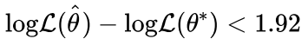
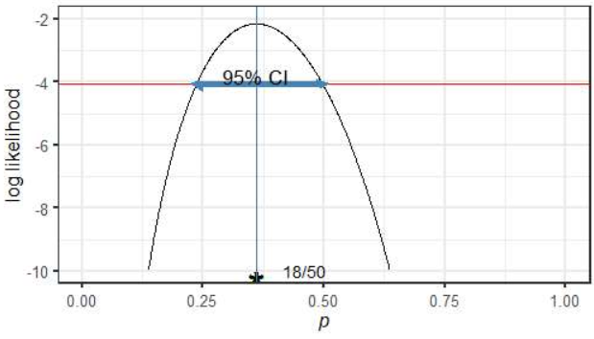
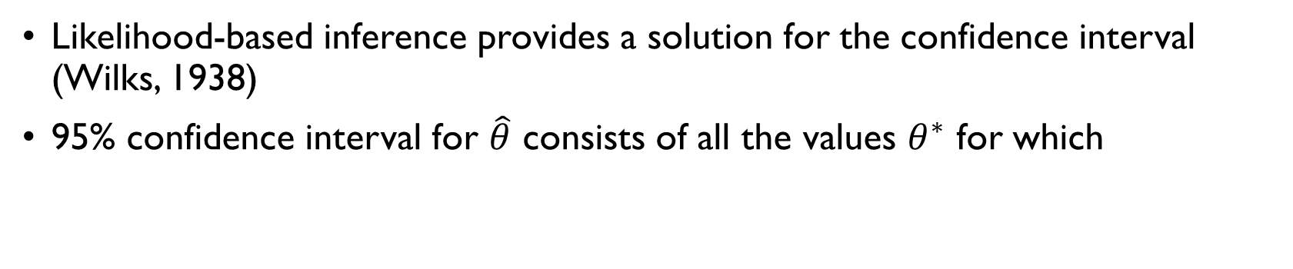
Confidence interval
Likelihood-based inference provides a solution for the confidence interval (Wilks, 1938)
95% confidence interval for $\hat{θ}$ consists of all the values $θ^{∗}$ for which

Slide 43
Case study

Slide 44
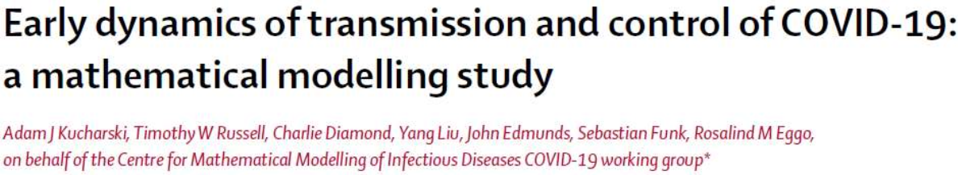
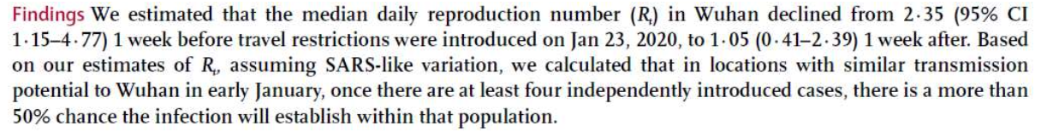
Estimate R₀ during COVID-19 outbreak in Wuhan

Slide 45
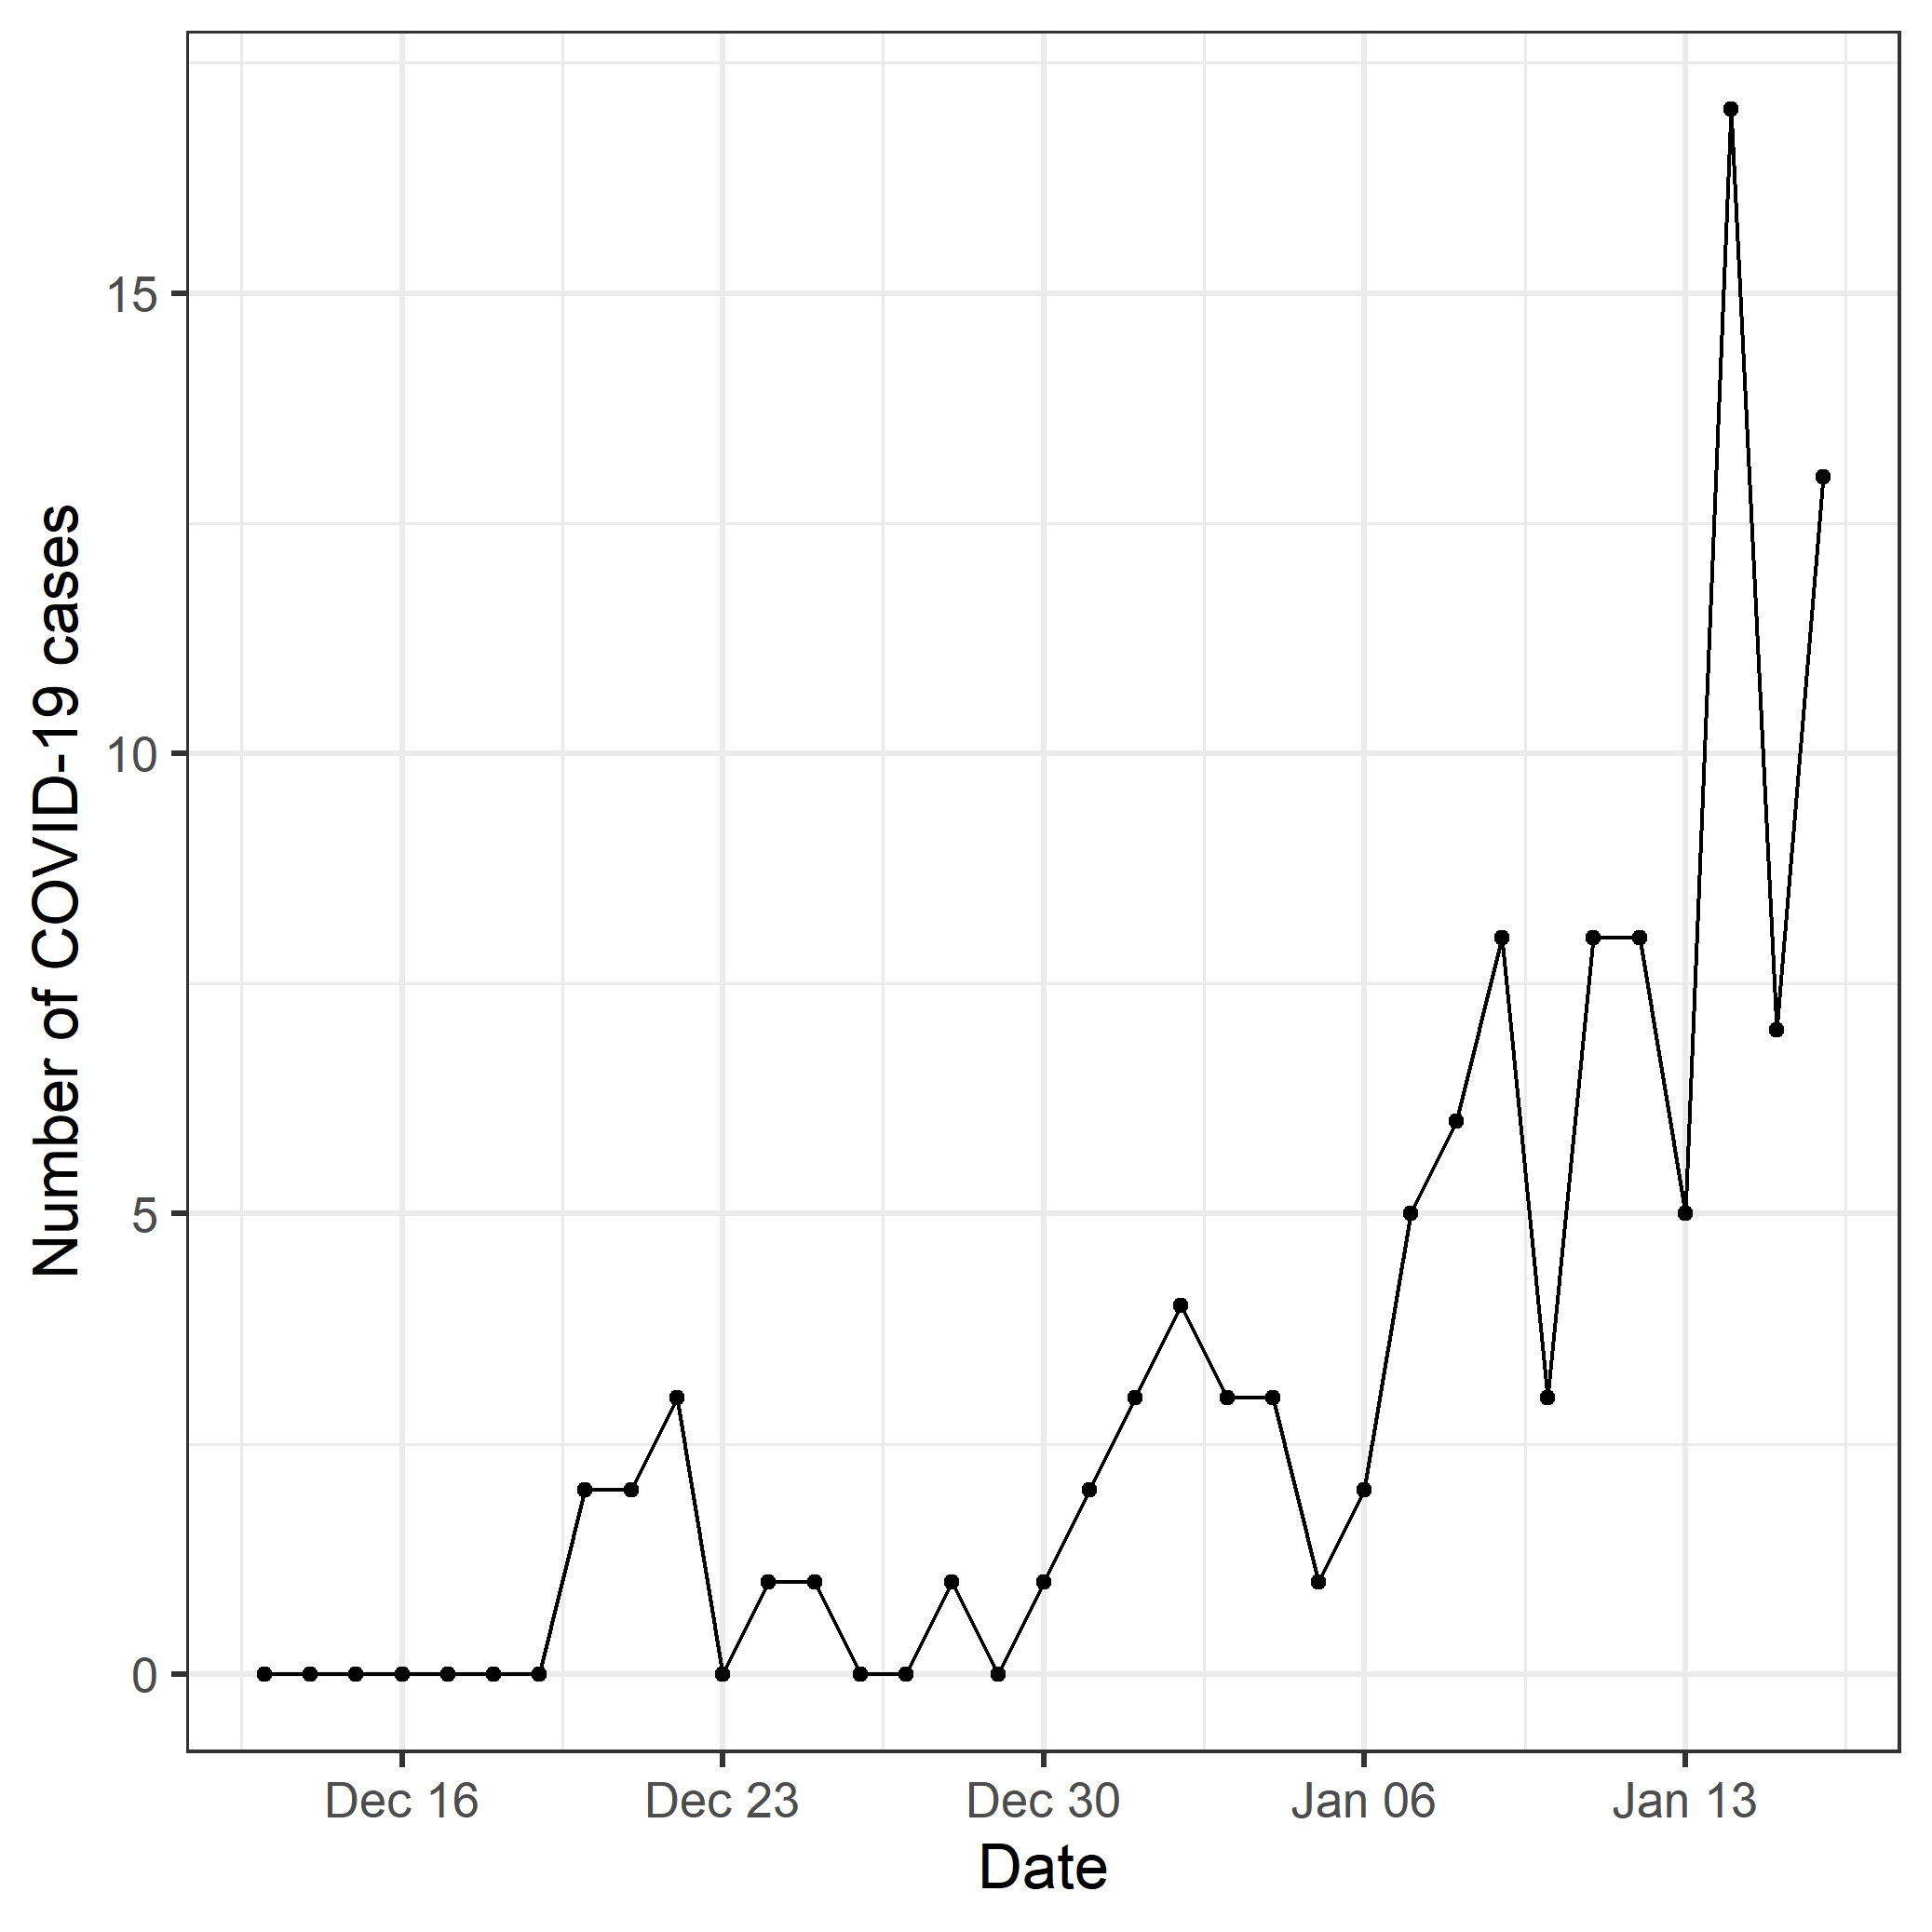
Reported daily number of COVID-19 cases

Slide 46
Modeling the process using the SEIR model
seir <- function( t, y, params) {
S <- y[1]; E <- y[2]; I <- y[3]; R <- y[4]; C <- y[5]
## now extract the parameters
beta <- params["beta"]
sigma <- params["sigma"]
gamma <- params["gamma"]
N <- S + E + I + R
muSE <- beta * I / N
muEI <- sigma
muIR <- gamma
dS <- - muSE*S
dE <- muSE*S - muEI*E
dI <- muEI*E - muIR*I
dR <- muIR*I
dC <- muEI*E
return(list(c(dS, dE, dI, dR, dC)))
}

Slide 47
Parameters, initial values, and simulation times
Parameters
y0 <- c(S = 11e6-1, E = 0, I = 1, R = 0, C=0)
R0 <- 2.5; dur_incub <- 5.2; dur_infect <- 4.5 # 2*(serial interval - incubation period)
params <- c(beta = R0/4.5, sigma=1/5.2, gamma = 1/4.5)
times <- seq(0, 35, by = 1)
Simulate using deSolve package
ode(y=y0, times = times, func = seir, parms = params) %>%
as.data.frame() -> out
trajectory <- function(params){
ode(y = y0, times = times, func = seir, parms = params) %>%
as.data.frame() -> out
return(out)
}

Slide 48
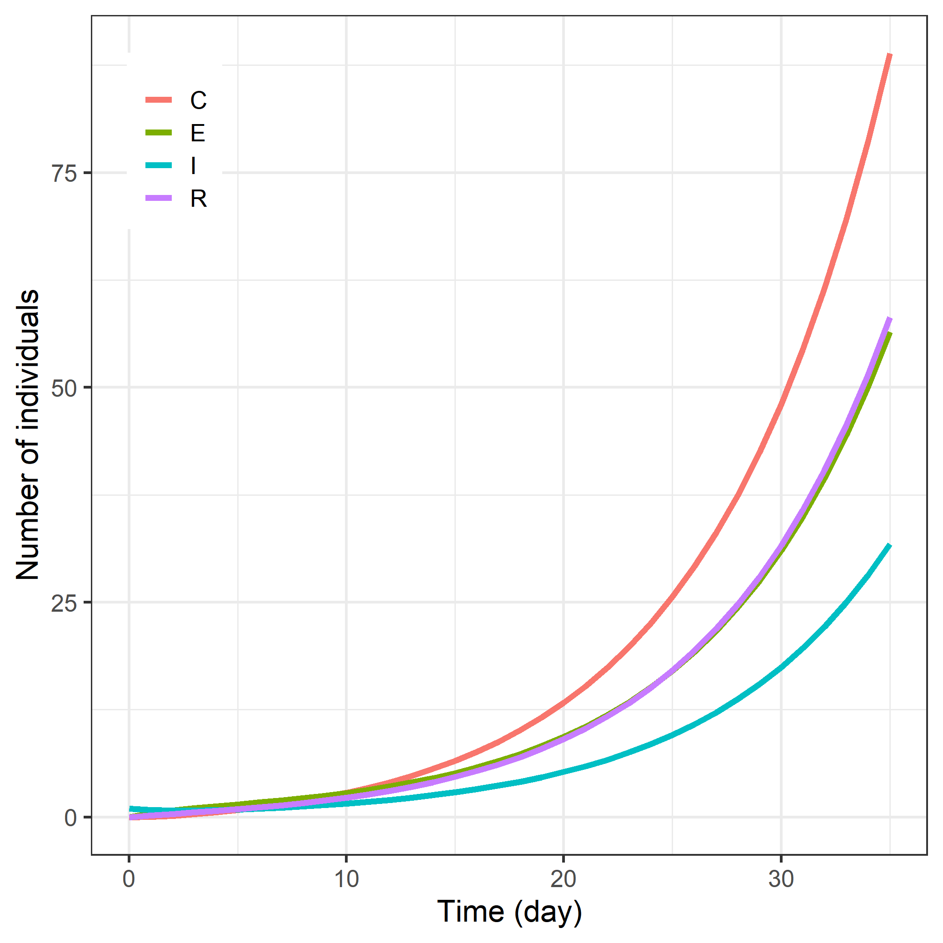
Dynamics of E, I, R, and C

Slide 49
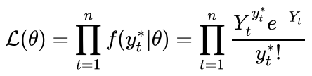
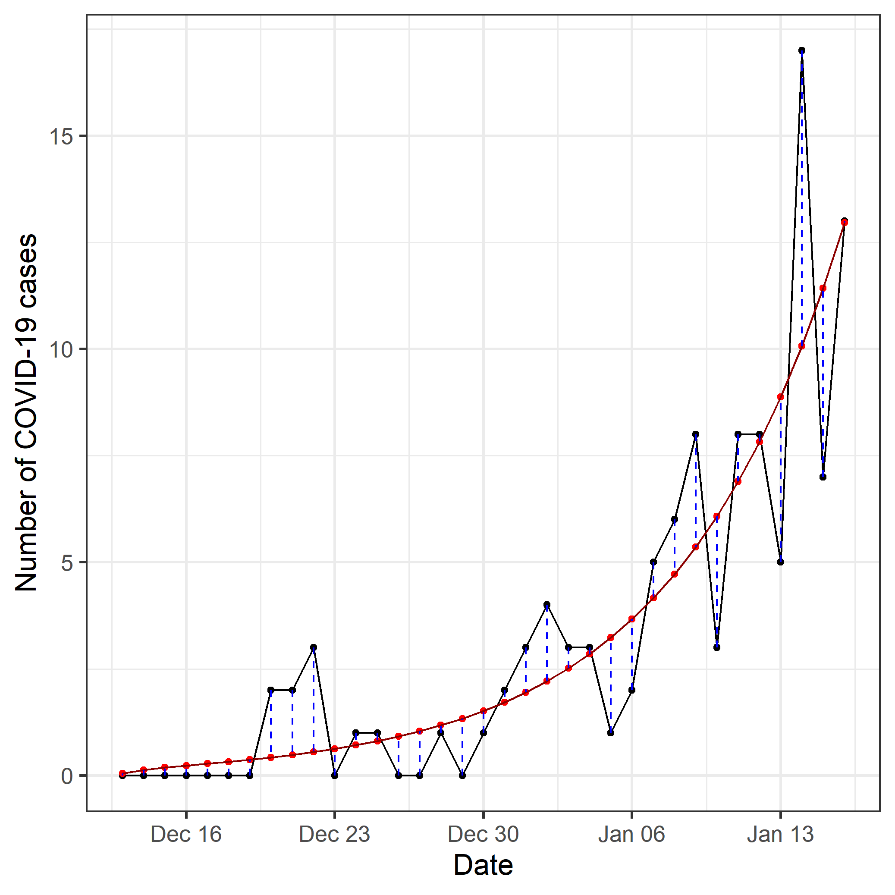
Modeling error using Poisson distribution

Slide 50
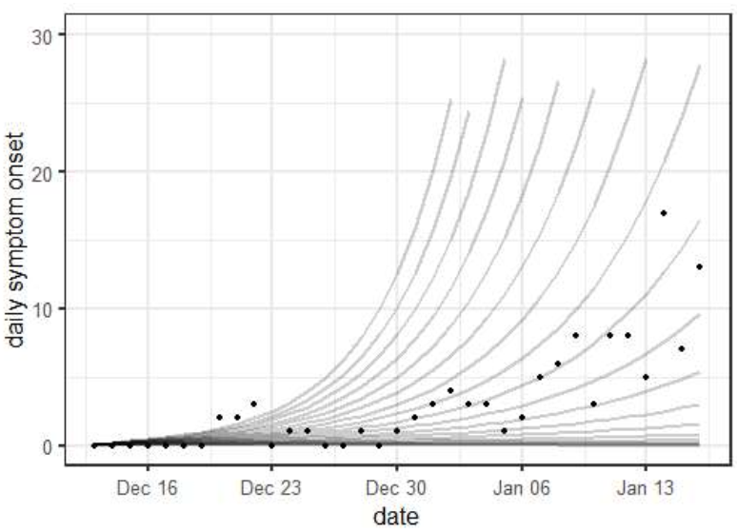

Daily symptom onset across varying $β$
beta <- seq(from = 0.1, to = 1, by = 0.05)

Slide 51
Maximize log-likelihood
Poisson likelihood function
poisson_loglik <- function(params) {
model <- daily_case( params = params)
sum(dpois(x = wuhan_data, lambda = model, log = TRUE))
}
stats::optim function
f4 <- function(par) {
params <- c(beta = par[1], sigma=1/5.2, gamma = 1/4.5)
- poisson_loglik(params)
}
fit4 <- optim(f4, par = c(0.1), method = "Brent", lower = 0, upper = 10)

Slide 52
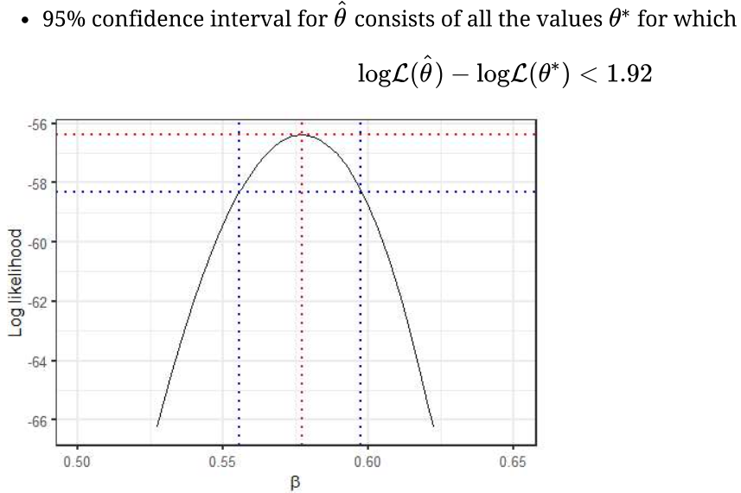
Confidence interval

Slide 53
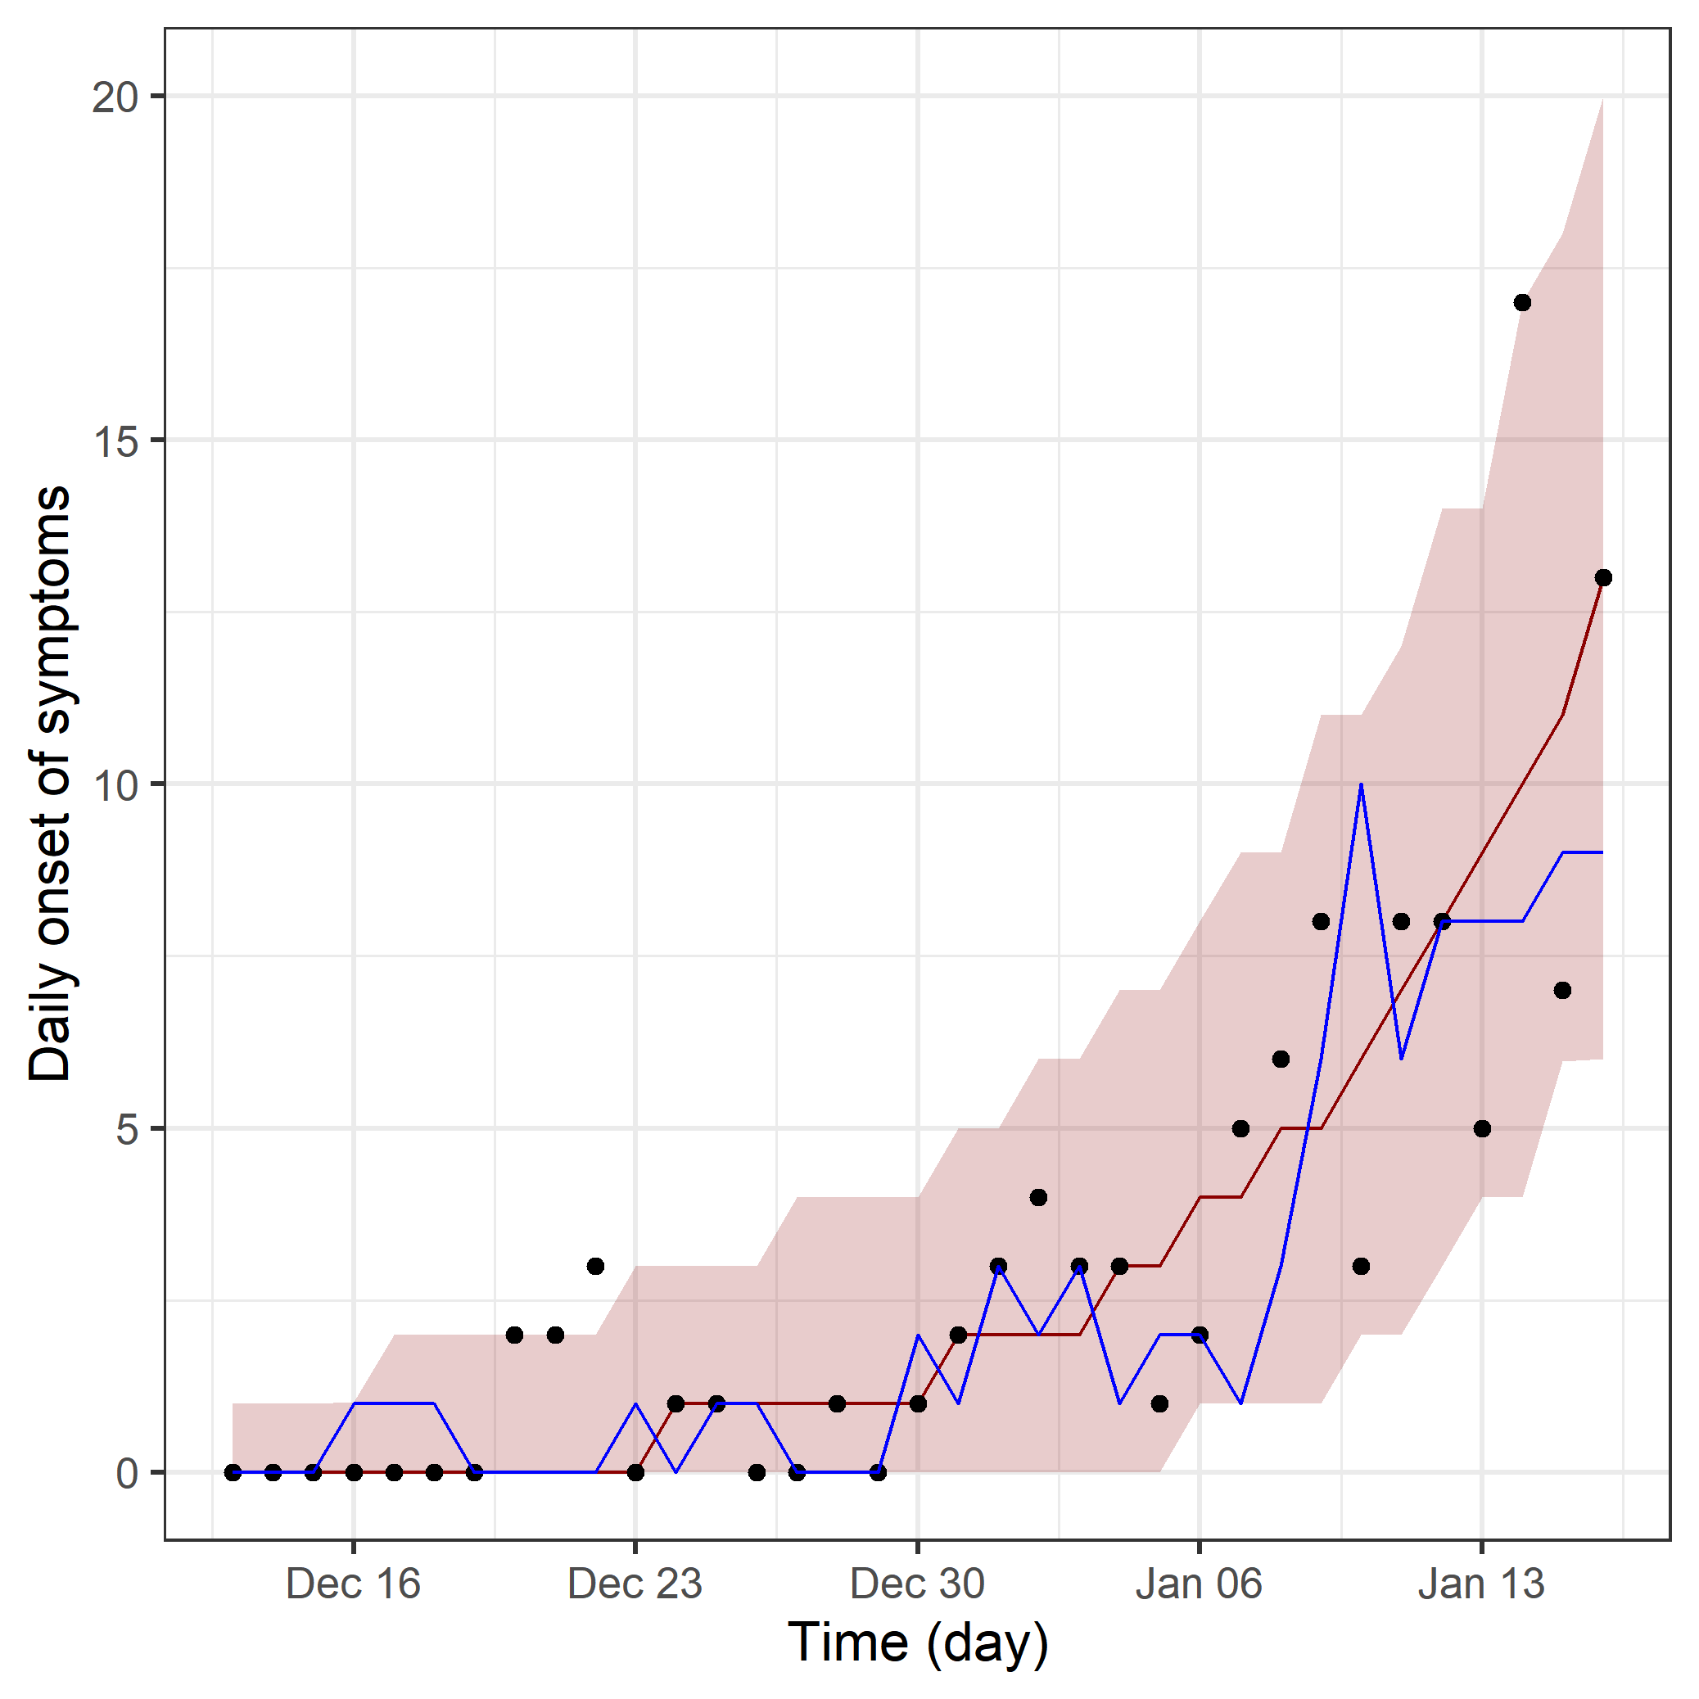
Model predictions at MLE
params <- c(beta = fit4$par, sigma = 1/5.2, gamma = 1/4.5)
model_pred <- daily_case(params)
simdat <- replicate(2000, rpois(n = length(model_pred), lambda = model_pred))
quantiles <- apply(simdat, 1, quantile, probs = c(0.025, 0.5, 0.975))
typical <- sample(ncol(simdat), 1)

Slide 54
Beyond the simple model
Additional states (e.g., vaccinated states) with more parameters and multiple data sets
Stochastic model to include process noise
Individual-based model to include individual behaviors
Model comparison
Bayesian inference

Slide 55
Summary
We seek to create simple, logically coherent models to study infectious disease transmission
SIR models can be implemented using a simple function and solved numerically in R
Likelihood-based methods provide a good framework for parameter estimation

Slide 56
Supplementary Material

Slide 57

Effective reproduction number (R_{t} or R_{eff})
(A) The instantaneous reproductive number
the number of new infections incident
at a single point in time (ti, blue arrow), relative to the number of infections in the previous generation (green arrows) and their current infectiousness (green curve)
(B), (C) The case reproductive number
the average number of new infections that
an individual who becomes infected on day ti (green arrows in B) or symptomatic on day ts (yellow arrows in C) will eventually go on to cause (blue downward arrows in B and C).

Slide 58



Stochastic model

Slide 59



Scientific modeling
Making a particular part or feature of the world easier to understand, define, quantify, visualize, or simulate (Scientific modelling, Wikipedia)
Doing so by referencing it to commonly accepted knowledge
Selecting and identifying relevant aspects of a situation in the real world
Different types of models for different aims (e.g., conceptual models to better understand and mathematical models to quantify)
Notes:
Widespread disinfection of community drinking water beginning in the early 20th century has led to the suppression of infectious diseases in wealthy countries. Subsequently, sustained investment into clean water infrastructure and improvements in sanitation and hygiene lead to one of the greatest public health achievements of the last century. While this level of success has lagged in many low and middle-income countries, incremental improvements in water, sanitation and hygiene (WASH) infrastructure may impart important benefits to populations living in disease endemic environments.

Slide 60

SARS-CoV 2 Transmission Routes
Notes:
Widespread disinfection of community drinking water beginning in the early 20th century has led to the suppression of infectious diseases in wealthy countries. Subsequently, sustained investment into clean water infrastructure and improvements in sanitation and hygiene lead to one of the greatest public health achievements of the last century. While this level of success has lagged in many low and middle-income countries, incremental improvements in water, sanitation and hygiene (WASH) infrastructure may impart important benefits to populations living in disease endemic environments.

Slide 61
Critical vaccination threshold
The minimum proportion of the population that must be immunized in order for the infection to die out in the population
To make R₀S = R < 1 through vaccination for a given R₀
S < 1/R₀ ==> make at least (1 – 1/R₀)*100 percent of the population protected from infection through vaccination
Critical vaccination threshold = (1 – 1/R₀) / VE *100 %

